Slide 1
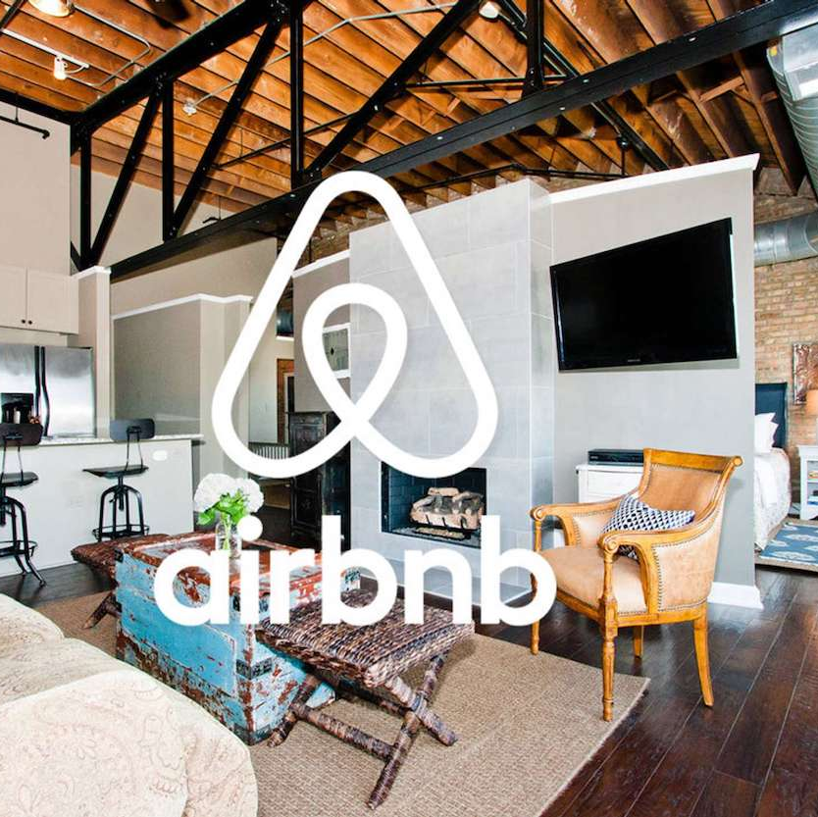
AirBnb Trends Los Angeles
Bianca Castro, Vismitha Narayanaswamy, and Selina Tseng
Assignment #3
Group 7
2/29/24

Slide 2
"Well, there’s lots of designers coming to town, so let’s offer them a place to stay with an air mattress, and it’ll be a whole experience. We’ll show them the city, etc."

Slide 3





Agenda
Initial Hypothesis
The Future of Home Sharing in Los Angeles
Successful Listing Characteristics
Analysis Wrap-Up
Looking Ahead

Slide 4




Initial Hypothesis
Room Type on Price and Success: Different room types (e.g., entire home/apartment, private room, shared room) may have different price distributions and thus may lead to differences in success.
Location Impact on Price & Success: The location of the property (neighborhood or neighborhood group) has a significant impact on the price of the home sharing and if a listing is successful.
Impact of Reviews: Properties with higher numbers of reviews or higher review scores may command higher prices.
Availability and Pricing: The availability of properties throughout the year could influence pricing, with low availability potentially leading to higher prices.

Slide 5
Future of Home Sharing in LA
Data-Driven results based on our Hypothesis
Average Price of Neighborhood
City of Los Angeles neighborhood will continue to increase
Listings of Unincorporated area will observe reduced prices
Average Price of Room Type
The average Price of Hotel Rooms will continue to increase

Slide 6
The Future of Home Sharing in LA

Slide 7
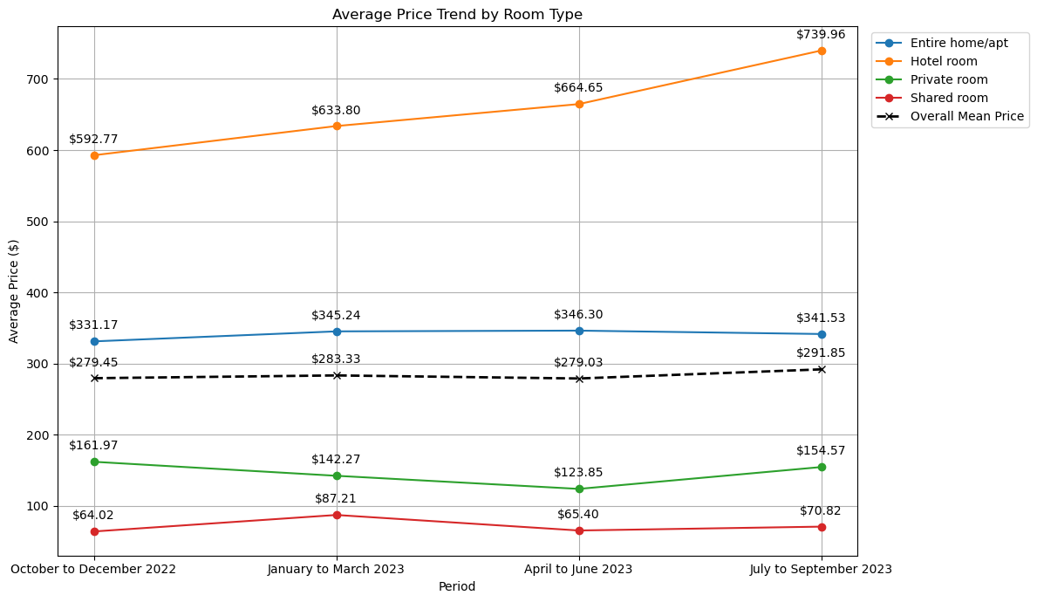
Average Prices by Room Types
Hotel room: The trend indicates a strong upward movement in prices. This is the steepest increase among all room types. If the trend continues, the cost of hotel stays in the future might be higher in the future.
Entire home/apt: The trend is relatively steady. If the trend continues, the price will probably stay stable.
Private room: The trend for private rooms is quite flat with a slight upward tilt. Private rooms might become a more attractive option for travelers if the price of hotels continues to rise.
Shared room: The mean price of shared rooms is also relatively stable, and probably will not change much over time.
*In the overall listing, the amount of entire home/apt > private rooms > shared rooms > hotel rooms.
Notes:
In the overall listing, the entire home/apt boasts the highest amount, followed by private rooms, shared rooms, and hotel rooms.

Slide 8
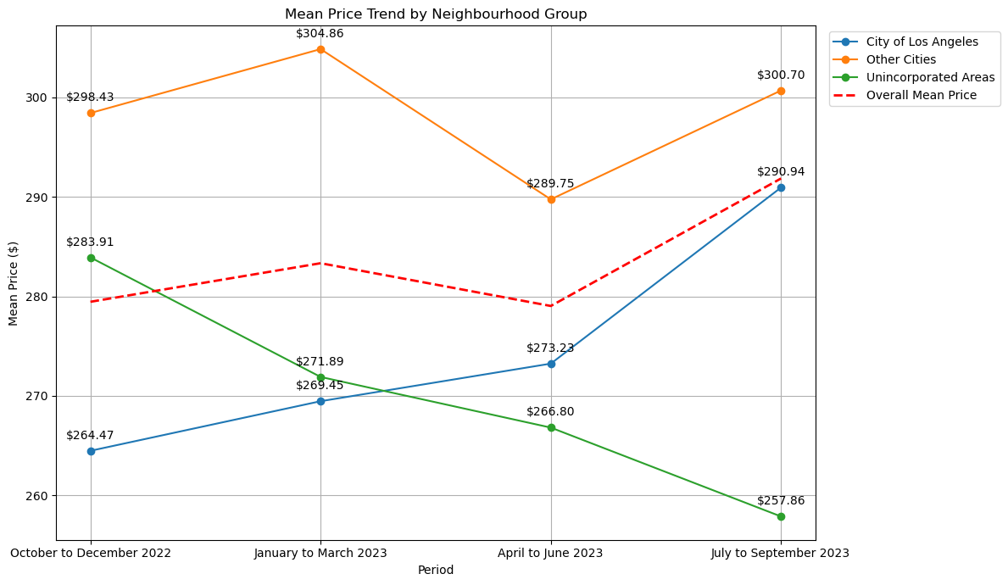
Average Price by Neighborhoods
City of Los Angeles: Given the steady increase, it may continue to experience rising prices.
Other Cities: The slight rise at the end suggests a potential stabilization or a modest increase after a period of volatility.
Unincorporated Areas: The consistent downward trend may continue unless there are significant changes
Overall Mean Price: If the City of Los Angeles continues its upward trend and if the Other Cities maintain or slightly increase their prices, the overall mean price may continue to rise since the City of Los Angeles is the neighborhood group that has the most listings.
*In the overall listing, listings in "City of LA" > "Other Cities" > "Unincorporated Areas"

Slide 9
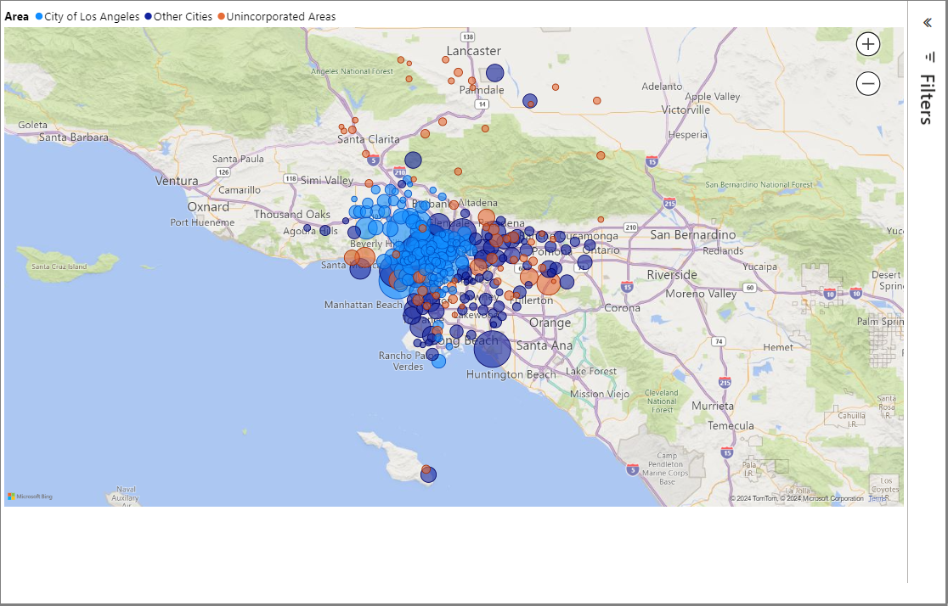
Total Airbnbs by Neighborhood
Proximity to Downtown: Airbnbs are concentrated around downtown LA, touristy neighborhoods, and along the coast. Neighborhoods like Long Beach, Santa Monica, and Hollywood have the most listings.
We can assume these neighborhoods will continue to attract more Airbnb guests since there is concentrated supply in these neighborhoods.
Note: A bigger circle indicates a higher median price. You may interact with this map by hovering your mouse around each dot to see the median price for each neighborhood.
Notes:
Looking at the median because some nbhds have extremities on both price ends, higher price Airbnb are in nbhds expected to be more expensive, continue to be more expensive

Slide 10


Limitations of Dataset
The time period of the dataset given was limited as it included the datapoints of 1 year after COVID. We could not get enough insights on the situation of house sharing pre-COVID and during COVID.
Since there is only the seasonal data for the years 2022 to 2023, there isn't enough data to support our forecasting on future trend.

Slide 11
Successful Listing Characteristics

Slide 12
Defining Successful Listings
Column "availabily_365" denotes the number of nights the listing was available for booking but not booked.
Successful listings: Less number of available nights because popular listings will be in high demand with low availability. Such listings will have nearly zero.
Additionally, we also consider "number_of_reviews", as there are many listings with zero availability.

Slide 13
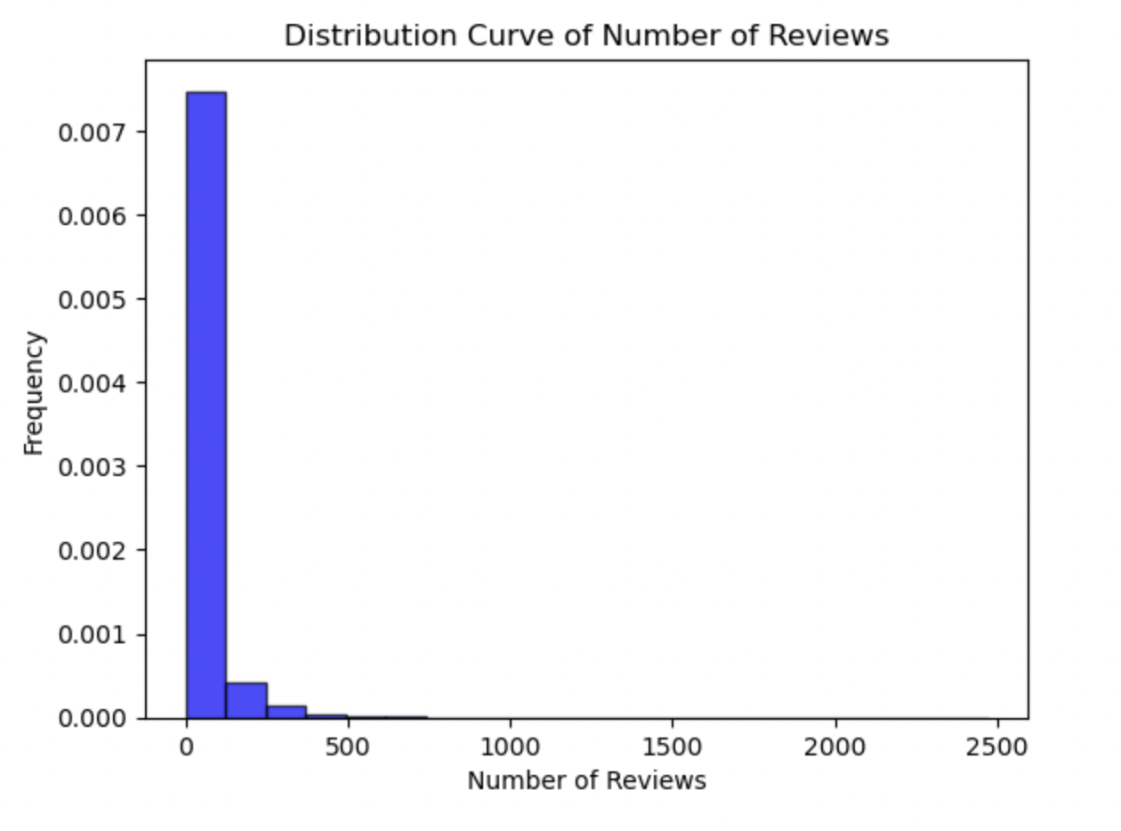
Defining Successful Listings
It is evident from the Distribution curve of Number of reviews, that most of the listings have < 100 reviews.
A very small portion of listings have reviews > 100, which could account for its fame and success.
50th percentile = 5 reviews
90th percentile = 97 reviews
Successful listing = ​ (availability_365 == 0 and number_of_reviews > 97)​

Slide 14
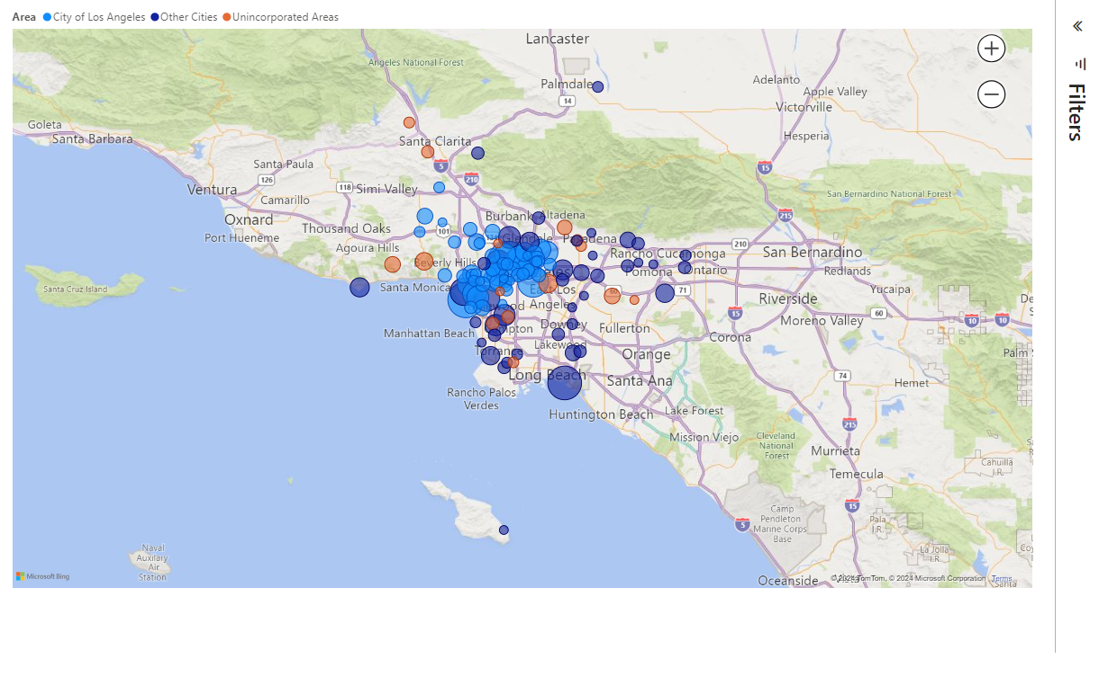
Successful Listings by Neighborhood
North and West of Downtown LA: Popular listings are concentrated in areas north and west of downtown LA. Neighborhoods south of downtown are not attractive to guests and, under our criteria of successful listings, did not appear in the results.
Proximity to Beach: Many popular listings along the coastline of Santa Monica and Long Beach.
Note: A bigger circle indicates more popular listings in that neighborhood. You may interact with this map by hovering your mouse around each dot to see the total number of listings for each neighborhood.
Notes:
Popular listings concentrated in downtown LA and along the beach, less popular listings the further you get from LA
North and west of downtown LA has the most popular listings. Hence, they are on high demand and filled throughout the year.

Slide 15
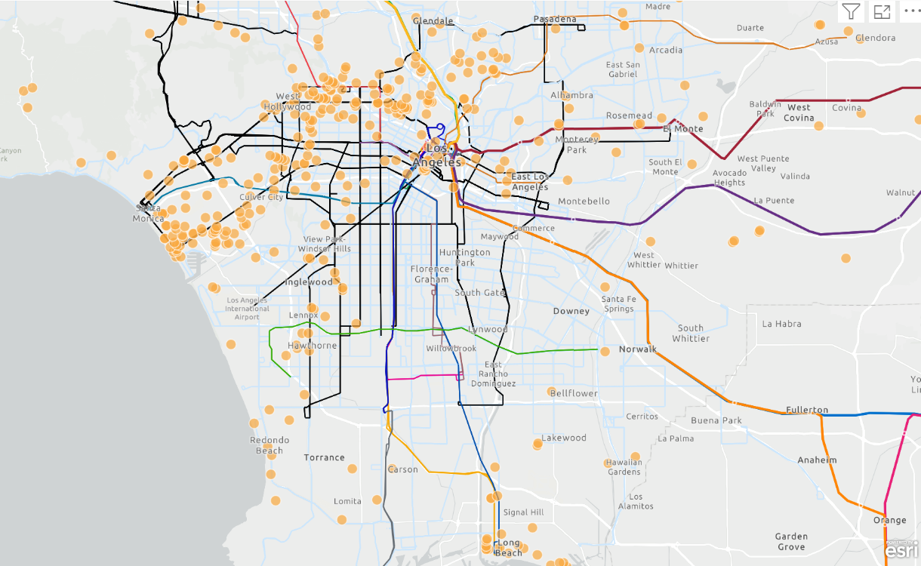
Does Public Transportation Impact Success?
Popular Airbnb Listing
Well Connected: Most popular listings are accessible to one or more major public transportation routes, or they are in walkable neighborhoods like Santa Monica.
Proximity Matters: There are a very few popular listings that are not connected by a major metro or bus route. This highlights guests desires to be near main attractions or near transportation stops to take them to LA attractions from their Airbnb.
Notes:
Listings reviews and popularity are highly correlated with their proximity to public transportation. Popular Listings are easily reachable by public transportation.

Slide 16
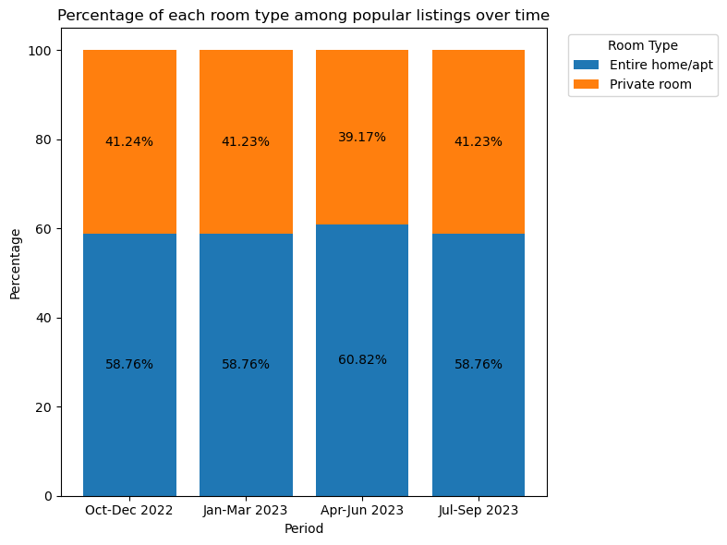
Successful Listings by Room Type
An entire home or apartment provides more privacy and space, which is a significant draw for families and groups traveling together.
Private residences often come with full kitchens and other home-like amenities that are not always available in a hotel setting.
Entire homes/apartments and private rooms could be more cost-effective, especially for longer stays or larger groups.
People might prefer entire homes or private rooms because they offer a more authentic local experience compared to the standardized offering of hotel rooms.
Notes:
Popular listings are mostly of type Apartments and Private rooms, which is relevant in the context of the COVID-19 pandemic. Having a private space minimizes contact with others, reducing the risk of transmission. This aligns with the preferences of travelers seeking to maintain social distancing measures during post-covid.

Slide 17
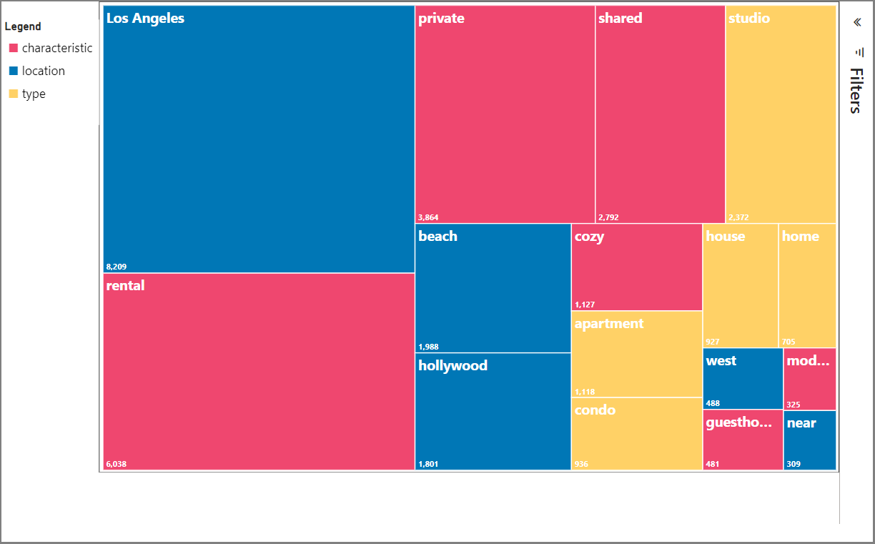
Themes Among Successful Listings
Methods: The “name” column was parsed to analyze the amount of times a word appeared in a listing’s name. Preposition words like “and,” “or,” “the”, etc. were removed since these words do not provide any insight into user preferences.
Themes:
Location: listings that indicate proximity or nearness to a certain location or within the city were popular
Airbnb Type: guests value listing type during search
Additional Characteristics: privacy vs. shared, long-term rentals, modern style and cozy vibes
Notes:
Popular Listings are named after popular destinations sites and the type of listing. This is a strategic approach because using the name of a popular destination in the listing title can enhance search visibility through SEO.
Travelers may be more likely to trust and choose a listing associated with a renowned destination. The name recognition of a popular site can create a sense of familiarity and confidence in potential guests.
Additional characteristics: shows success aligned with greater social trends like modern apartment designs and appliances and guests values of cozyness and personalization of airbnb

Slide 18
Key Takeaways
Location and Room Type are Critical Factors: The analysis highlights that the location of the Airbnb listing and the type of room offered significantly influenced pricing strategies and popularity among guests. Certain neighborhoods, especially those close to tourist attractions or in premium areas, command higher prices.
Popularity and Pricing Insights for Future Trends: These insights can help predict future trends in the home-sharing market in Los Angeles, indicating a potential increase in prices for listings in desirable locations and for preferred room types.

Slide 19
Looking Ahead
The future of Airbnb in LA is bright!
Annual visitors to the Los Angeles region are projected to rise to more than 70 million by the year 2030.
LA poised to welcome millions of guests for FIFA and Olympic Games in 2026 and 2028.
Tourism master plan - city of Los Angeles. Los Angeles City Tourism Department. (2020). https://tourism.lacity.gov/sites/g/files/wph1946/files/2021-08/Tourism_Master_Plan.pdf

Slide 20

Thank you!

Slide 21
Appendix
Data files: Google Drive with Code and PowerBI Dashboards

Slide 22
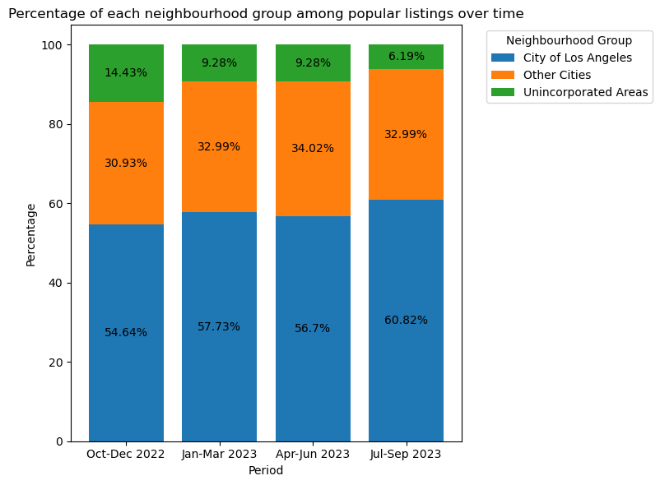
Other visualizations

Slide 23
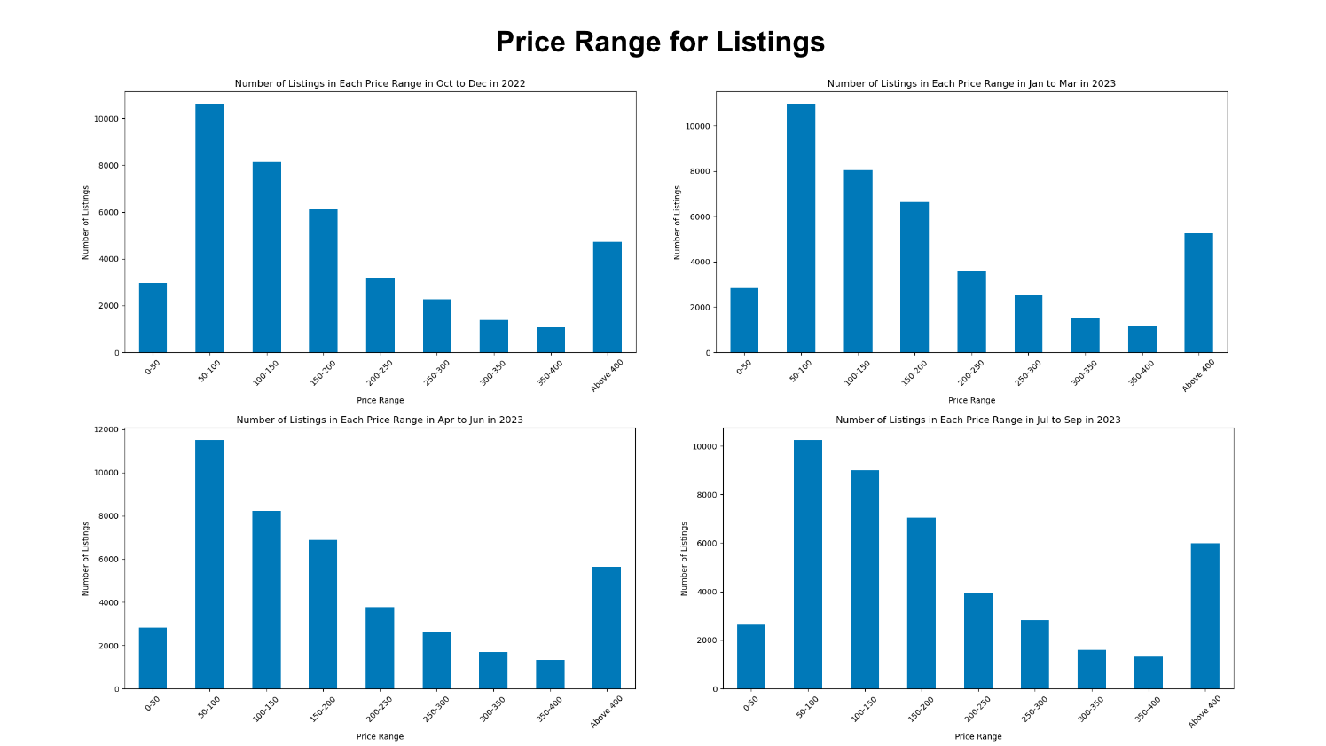

Slide 24
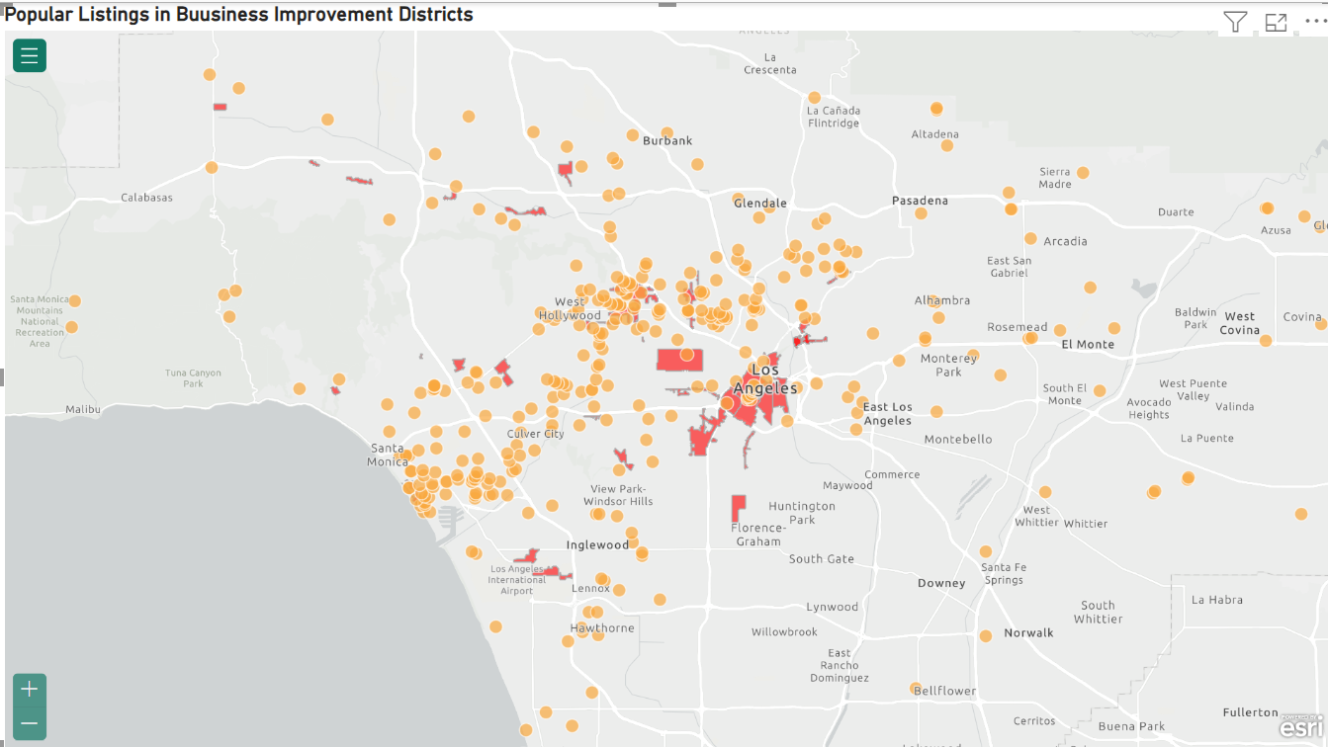
Popular Listings in LA Designated Business Improvement Districts

Slide 25

Characteristics of Successful Listings
North and west of downtown LA has the most popular listings. Hence, they are on high demand and filled throughout the year.
Reviews and popularity are highly correlated with their proximity to public transportation. Popular Listings are easily reachable by public transportation.
Popular listings are mostly of type Apartments and Private rooms, which is relevant in the context of the COVID-19 pandemic. Having a private space minimizes contact with others, reducing the risk of transmission. This aligns with the preferences of travelers seeking to maintain social distancing measures during post-covid.
Popular Listings are named after popular destinations sites and the type of listing. This is a strategic approach because using the name of a popular destination in the listing title can enhance search visibility through SEO.
Travelers may be more likely to trust and choose a listing associated with a renowned destination. The name recognition of a popular site can create a sense of familiarity and confidence in potential guests.

